Slide 1

India Health – Clinical Laboratory Report Generation System
Under The Guidance Of
Prof. Ravi Nimavat
Developed By
Smit Bosamiya (210511214006)
Jishan Bhatti (210511214002)
Manisha Karma (210511207024)
Submitted To:
Department of MCA & M. Sc. (IT)
Faculty of IT & Computer Science,
PARUL University

Slide 2
Index
Project Profile
1.1 Project Definition
1.2 Project Description
1.3 Existing System
1.4 Problem Statements
1.5 Need for New System
1.6 Proposed System & Features
1.7 Scope
1.8 Outcomes
1.9 Tools & Technology used
Requirement Analysis
2.1 Feasibility Study
2.2 Users of the System
2.3 Modules
2.4 Process Model
2.5 Hardware & Software Requirements
2.6 Use Cases
2.7 Use Case Diagram

Slide 3
1. Project Profile
1.1 Project Definition
“India Health" is a web application where the user can login, registration and view their clinical reports, his/her health data and near by doctors and laboratory etc.
1.2 Project Description
India Health is platform where user can view their clinical reports, doctors can create a new query for a report towards the patient, laboratories can fill details to the new report or the query created by the doctors, this all reports are stored in this system and accessible any time by patient, doctors and laboratories.

Slide 4
1.3 Existing System
In earlier, all clinical reports are printed by laboratories, and patient needs to carry those hard copy to the doctors. Sometimes patient lose those report and need to reprint them. But nowadays many laboratory management system are available and creating reports. But it’s doesn’t full fill all requirements.
1.4 Problem Statements
Generating and storing reports digitally.
Connecting Patient, Doctors and Laboratories together on single platform.

Slide 5
1.5 Need for New System
“India Health” is a web application. The purpose of online report generation system to automate the existing manual system by the help of computerized equipment’s and full flag computer software fulfilling their requirements so that their valuable data information can be stored for a longer period with easy accessing and manipulation of the same the required Software and Hardware are easily available and easy to work with.
1.6 Proposed System & Features
India Health is web application and it is very helpful for the patient, doctors and laboratories to generate and store clinical reports. Patient can access their reports form anywhere any time.

Slide 6
1.7 Scope
Provides a Registration Form for filling up new users’ details.
Provides a facility to view and print his/her clinical report.
Provides a facility to register as doctor/laboratory.
Provides a facility to generate report query by doctors.
Provides a facility to fill/print report by laboratory.
1.8 Outcomes
It will run on web browser. Online portal where patient's can access their report from anywhere anytime.
1.9 Tools & Technology used
Frontend: HTML, CSS, JS, Bootstrap.
Backend: PHP & MySQL with Apache Server.

Slide 7
2. Requirement Analysis
2.1 Feasibility Study
Operational feasibility
It defines how well a solution works for the problem and how the system is usable for the end-users. As far our study is concerned the end-users are comfortable and happy as the system has cut down their loads and doing.
Technical Feasibility
This included the study of function, performance and constraints that my affect the ability to achieve an acceptable system, as described in the System Requirement Specification (SRS), and checked if everything was possible using different type of frontend and backend platforms.

Slide 8
Economic Feasibility
This is a very important aspect to be considered while developing a project.
We decided the technology based on minimum possible cost factor.
Implementation Feasibility
Implementation Feasibility deals with the study of whether the service is environment available with all association members and will be managed according to the system or not.

Slide 9
2.2 Users of the System
There will be Five types of Members (Admin, Helper, Doctor, Laboratory, Patient).
Patient
Log in/Log out/Update-Password
register and log in with their credentials.
Find Laboratory/Doctor by Pin code
View his/her Clinical Reports.
View Clinical Health Analysis.
Generate Query for help/issue.
Apply to get role as laboratory/docotor
Admin
Log in/ Logout.
Manage Users/Doctors/Laboratory

Slide 10
Manage View Reports
Manage Queries
Manage Templates, Groups and Units
Helper
Manage Users/Doctors/Laboratory
Manage Quries
Doctor
View Reports
Generate Report Query
Laboratory
Fill and Manage Reports

Slide 11
2.3 Modules
• Login/Register
• Templates/Groups/Units
• Doctors
• Laboratories
• Reports
• Contact Form
• Queries

Slide 12
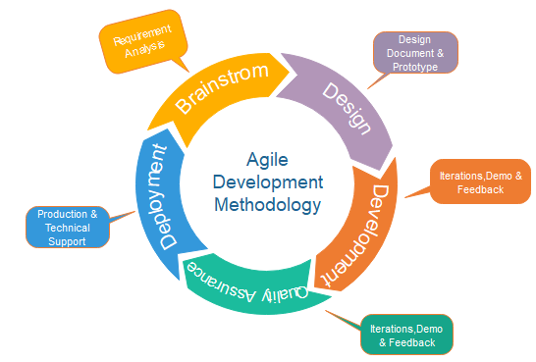
2.4 Process Model
The Software process model chosen for the project is the “Agile Model”.

Slide 13
2.5 Hardware & Software Requirements
Server-Side Requirements
Hardware
Ram | 8 GB
SSD | Needed
Software
Operating System | Windows 10
Database | MySQL
Backend | PHP
Front-End | HTML, CSS & JS & BS4
Tool | Visual Studio Code

Slide 14
2.5 Hardware & Software Requirements
Client-Side Requirements
Hardware
Ram | 4 GB
Device | Smart Device
Software
Operating System | Any OS
Application software | Any Web Brower
System Connected | Internet

Slide 15
2.6 Use Cases
1. Actor: User
Actions
Signup
Login
Switch Role
View Health
View Report
Edit Profile
Submit Contact Form
2. Actor: Admin
Actions
View Report
Add Patient
Manage Users
Manage Laboratory
Manage Doctors
Manage Reports
Manage Queries
Manage Contact form Submissions

Slide 16
3. Actor: Helper
Actions
View Report
Add Patient
Manage Users
Manage Laboratory
Manage Doctors
Manage Reports
Manage Queries
4. Actor: Doctor
Actions
Register
Add Patient
Create Report
View Report

Slide 17
5. Actor: Laboratory
Actions
Register
Add Patient
Create Report
View Report
Fill Report

Slide 18
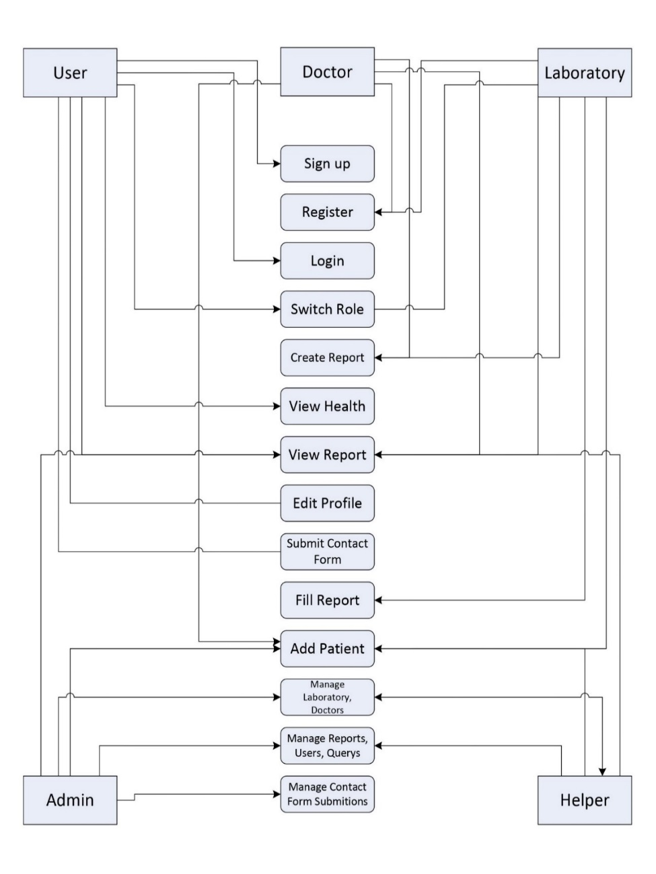
2.7 Use Cases Diagram

Slide 19
3 Design
3.1 Use Case Scenarios
User Sign up.
User Sign in
Use Case ID | UC001
Primary Actor | User
Precondition | Email must be not Resisted in our System.
Basic Flows of Events. | User Fill the signup form and click on signup button.
Alternative Way | There is no alternative way.
Use Case ID | UC002
Primary Actor | User
Precondition | Username and password should be match with database.
Basic Flows of Events. | User Fill the sign in form and click on signup button.
Alternative Way | There is no alternative way.

Slide 20
View Report
Register for Doctor
Register for Laboratory
Use Case ID | UC003
Primary Actor | User, Doctor, Laboratory, Admin, Helper
Precondition | Report ID need to exist and the user role must be authorized to view that report
Basic Flows of Events. | User go to report page and click on view report page.
Alternative Way | Link Received via mail to the user’s email address.
Use Case ID | UC004
Primary Actor | User
Precondition | No Precondition for this.
Basic Flows of Events. | User fills Doctor Registration form and click on register.
Alternative Way | There is no alternative way.
Use Case ID | UC005
Primary Actor | User
Precondition | No Precondition for this.
Basic Flows of Events. | User fills Laboratory Registration form and click on register.
Alternative Way | There is no alternative way.

Slide 21
Add Patient
Create Report
Fill Report
Use Case ID | UC006
Primary Actor | Admin, Helper, Doctor, Laboratory
Precondition | Email must be not Resisted in our System.
Basic Flows of Events. | User Fill the Add patient form and click on add button.
Alternative Way | There is no alternative way.
Use Case ID | UC007
Primary Actor | Doctor, Laboratory
Precondition | User ID, and DOB must be present in database
Basic Flows of Events. | User Fill the Create Report form and click on Create.
Alternative Way | There is no alternative way.
Use Case ID | UC008
Primary Actor | Laboratory
Precondition | Need to Present in Fill Report Section.
Basic Flows of Events. | Laboratory Technician will Click on Fill Report Button and Fill the Report.
Alternative Way | There is no alternative way.

Slide 22
Manage Queries
Manage Contact Form
Use Case ID | UC009
Primary Actor | Admin, Helper
Precondition | No Precondition for this.
Basic Flows of Events. | Go to Queries Section and Manage
Alternative Way | There is no alternative way.
Use Case ID | UC001
Primary Actor | Admin
Precondition | No Precondition for this.
Basic Flows of Events. | Go to Contact form section and manage.
Alternative Way | There is no alternative way.

Slide 23
Thank You

